Slide 1
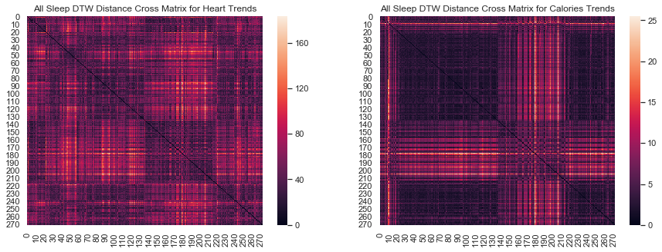
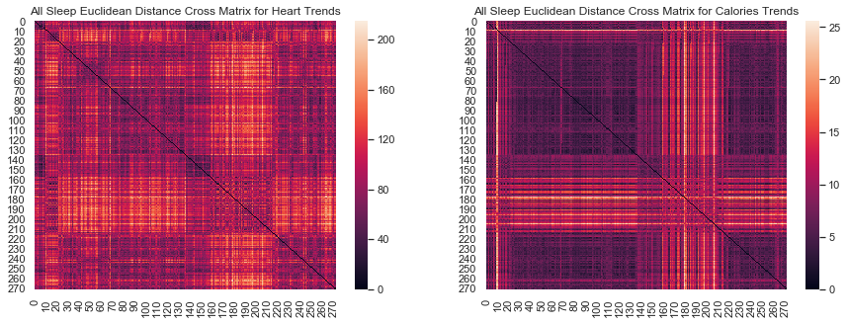
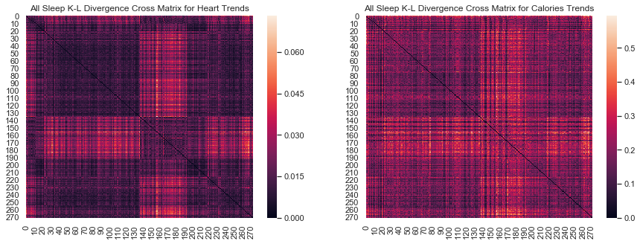
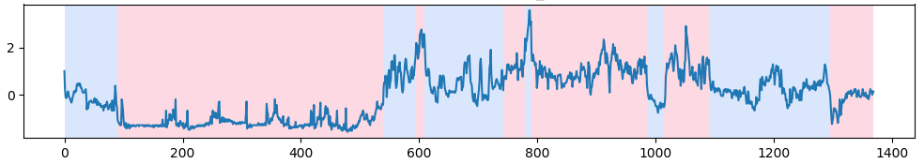
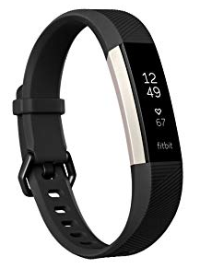
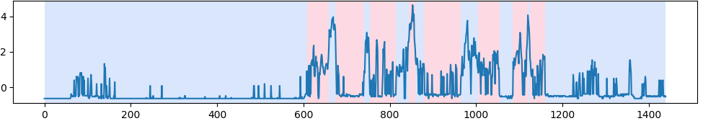
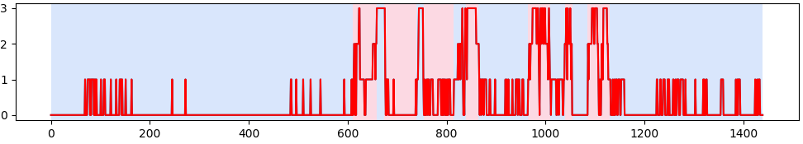
Activity Recipes for High Sleep Efficiency
using Wearable Device Data
Saksham Goel | goelx029 | 5138568
University of Minnesota Twin Cities
Abstract
Methodology
Results
My project aims to apply clustering techniques over intraday time series data collected from wearable devices like Fitbit to help extract activity recipes for high sleep efficiency which will further be supplied to a activity recommendation engine. In this project I am trying to evaluate different distance measures and their effectiveness in processing time series data for heart rate, calories, steps, sleep and activity. For this project I focused on clustering heart rate time series in time and frequency (using a fast fourier transform) domain using different distance metrics like L-1 Norm, L-2 Norm (Euclidean), Dynamic Time Warping (DTW), and Kullback Leibler Divergence evaluating the performance of the activity level recipes learned from these clusters for recommendation for better sleep efficiency.
Add your information, graphs and images to this section.
Add your information, graphs and images to this section.
Add your information, graphs and images to this section.
Introduction
Inadequate sleep negatively affects both mental and physical well-being, and exacerbates many non-communicable health problems such as diabetes, depression, cancer and obesity. Therefore a good night’s sleep is of paramount importance to each person for their overall well being. My project aims to extract high confidence, actionable knowledge of activity recipes for high sleep from low cost, ubiquitous, low fidelity data for health and wellness from the wearable devices like Fitbit. These activity recipes will further be supplied to a activity recommendation engine for user recommendations during their daily life.
People have already worked on recommending activities based on recipes learned from clustering over activity patterns of the user data. However this project aims to use data about a person’s current health being i.e. heart rate data to cluster biologically similar people into clusters and then learn their activity patterns to recommend activities. In this project I have applied K-Means clustering over intraday time series data in two steps to find the clusters and learn the best activity recipes for high sleep efficiency.
Conclusion
Add your information, graphs and images to this section.
Activity Recommendation

